Slide 1

Spring 5
Core MVC REST DATA JPA DATA REST

Slide 2
Spring Core
Understanding SPRing framework
Creating Beans
Working with different configurations

Slide 3
Spring FrameWork Overview
The Spring Framework is a lightweight solution and a potential one-stop-shop for building your
enterprise-ready applications. However, Spring is modular, allowing you to use only those parts that you
need, without having to bring in the rest. You can use the IoC container, with any web framework on
top, but you can also use only the Hibernate integration code or the JDBC abstraction layer. The Spring
Framework supports declarative transaction management, remote access to your logic through RMI or
web services, and various options for persisting your data. It offers a full-featured MVC framework, and
enables you to integrate AOP transparently into your software.

Slide 4
Spring Framework Overview
Spring is designed to be non-intrusive, meaning that your domain logic code generally has no dependencies on the framework itself. In your integration layer (such as the data access layer), some dependencies on the data access technology and the Spring libraries will exist. However, it should be easy to isolate these dependencies from the rest of your code base.

Slide 5
Introduction to Spring
The Spring Framework is a Java platform that provides comprehensive infrastructure support for developing Java applications. Spring handles the infrastructure so you can focus on your application. Spring enables you to build applications from "plain old Java objects" (POJOs) and to apply enterprise services non-invasively to POJOs. This capability applies to the Java SE programming model and to full and partial Java EE

Slide 6
Examples of how you, as an application developer, can benefit from the Spring platform:
• Make a Java method execute in a database transaction without having to deal with transaction APIs.
• Make a local Java method a remote procedure without having to deal with remote APIs.
• Make a local Java method a management operation without having to deal with JMX APIs.
• Make a local Java method a message handler without having to deal with JMS APIs.

Slide 7
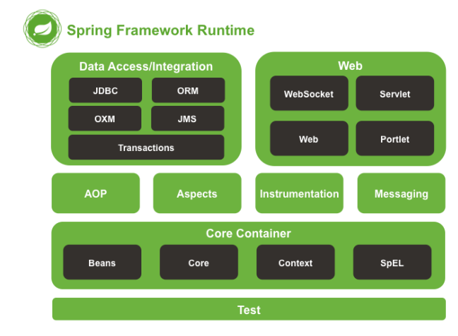
Modules in Spring

Slide 8
Spring Core Module
The Core Container consists of the spring-core, spring-beans, spring-context, springcontext-support, and spring-expression (Spring Expression Language) modules.
The spring-core and spring-beans modules provide the fundamental parts of the framework, including the IoC and Dependency Injection features.
The BeanFactory is a sophisticated implementation of the factory pattern. It removes the need for programmatic singletons and allows you to decouple the configuration and specification of dependencies from your actual program logic

Slide 9
Spring-Context
The Context (spring-context) module builds on the solid base provided by the Core and Beans modules: it is a means to access objects in a framework-style manner that is similar to a JNDI registry. The Context module inherits its features from the Beans module and adds support for internationalization (using, for example, resource bundles), event propagation, resource loading, and the transparent creation of contexts by, for example, a Servlet container. The Context module also supports Java EE features such as EJB, JMX, and basic remoting. The ApplicationContext interface is the focal point of the Context module. spring-context-support provides support for integrating common third-party libraries into a Spring application context, in particular for caching (EhCache, JCache) and scheduling (CommonJ, Quartz).

Slide 10
AOP and Instrumentation
The spring-aop module provides an AOP Alliance-compliant aspect-oriented programming implementation allowing you to define, for example, method interceptors and pointcuts to cleanly decouple code that implements functionality that should be separated. Using source-level metadata functionality, you can also incorporate behavioral information into your code, in a manner similar to that of .NET attributes.

Slide 11
Messaging
Spring Framework 4 includes a spring-messaging module with key abstractions from the Spring Integration project such as Message, MessageChannel, MessageHandler, and others to serve as a foundation for messaging-based applications. The module also includes a set of annotations for mapping messages to methods, similar to the Spring MVC annotation based programming model.

Slide 12
Data Access / Integration
The Data Access/Integration layer consists of the JDBC, ORM, OXM, JMS, and Transaction modules.
The spring-jdbc module provides a JDBC-abstraction layer that removes the need to do tedious JDBC coding and parsing of database-vendor specific error codes.
The spring-tx module supports programmatic and declarative transaction management for classes that implement special interfaces and for all your POJOs (Plain Old Java Objects).
The spring-orm module provides integration layers for popular object-relational mapping APIs, including JPA and Hibernate. Using the spring-orm module you can use these O/R-mapping frameworks in combination with all of the other features Spring offers, such as the simple declarative transaction management feature mentioned previously.
The spring-oxm module provides an abstraction layer that supports Object/XML mapping implementations such as JAXB, Castor, JiBX and XStream.
The spring-jms module (Java Messaging Service) contains features for producing and consuming messages. Since Spring Framework 4.1, it provides integration with the spring-messaging module.

Slide 13
Web module
The Web layer consists of the spring-web, spring-webmvc and spring-websocket modules.
The spring-web module provides basic web-oriented integration features such as multipart file upload functionality and the initialization of the IoC container using Servlet listeners and a web-oriented application context. It also contains an HTTP client and the web-related parts of Spring’s remoting support
The spring-webmvc module (also known as the Web-Servlet module) contains Spring’s modelview-controller (MVC) and REST Web Services implementation for web applications. Spring’s MVC framework provides a clean separation between domain model code and web forms and integrates with all of the other features of the Spring Framework.

Slide 14
Test
The spring-test module supports the unit testing and integration testing of Spring components with JUnit or TestNG. It provides consistent loading of Spring ApplicationContexts and caching of those contexts. It also provides mock objects that you can use to test your code in isolation.

Slide 15
Spring IoC container and beans
IoC is also known as dependency injection (DI).
It is a process whereby objects define their dependencies, that is, the other objects they work with, only through constructor arguments, arguments to a factory method, or properties that are set on the object instance after it is constructed or returned from a factory method.
The container then injects those dependencies when it creates the bean. This process is fundamentally the inverse, hence the name Inversion of Control (IoC), of the bean itself controlling the instantiation or location of its dependencies by using direct construction of classes, or a mechanism such as the Service Locator pattern.

Slide 16
Spring IoC container and beans
The org.springframework.beans and org.springframework.context packages are the basis for Spring Framework’s IoC container. The BeanFactory interface provides an advanced configuration mechanism capable of managing any type of object. ApplicationContext is a subinterface of BeanFactory. It adds easier integration with Spring’s AOP features; message resource handling (for use in internationalization), event publication; and application-layer specific contexts such as the WebApplicationContext for use in web applications
In Spring, the objects that form the backbone of your application and that are managed by the Spring IoC container are called beans. A bean is an object that is instantiated, assembled, and otherwise managed by a Spring IoC container. Otherwise, a bean is simply one of many objects in your application. Beans, and the dependencies among them, are reflected in the configuration metadata used by a container

Slide 17
Spring IoC Container overview
The interface org.springframework.context.ApplicationContext represents the Spring IoC container and is responsible for instantiating, configuring, and assembling the aforementioned beans.
The container gets its instructions on what objects to instantiate, configure, and assemble by reading configuration metadata.
The configuration metadata is represented in XML, Java annotations, or Java code. It allows you to express the objects that compose your application and the rich interdependencies between such objects.

